Slide 1
8086 Interrupts

Slide 2
Introduction
Most Microprocessors allow normal program execution to be interrupted by some external signal or by a special instruction in the program.
In response to an interrupt, the microprocessor stops executing it’s current program and call a procedure which serves the interrupt.

Slide 3
Sources
An 8086 interrupt can come from any one of the three sources.
External signal applied to NMI pin or INTR input pin . . . . Hardware interrupt
Execution of Interrupt instruction, INT . . . . software interrupt
Some error condition produced by executing an instruction i.e. divide by zero

Slide 4
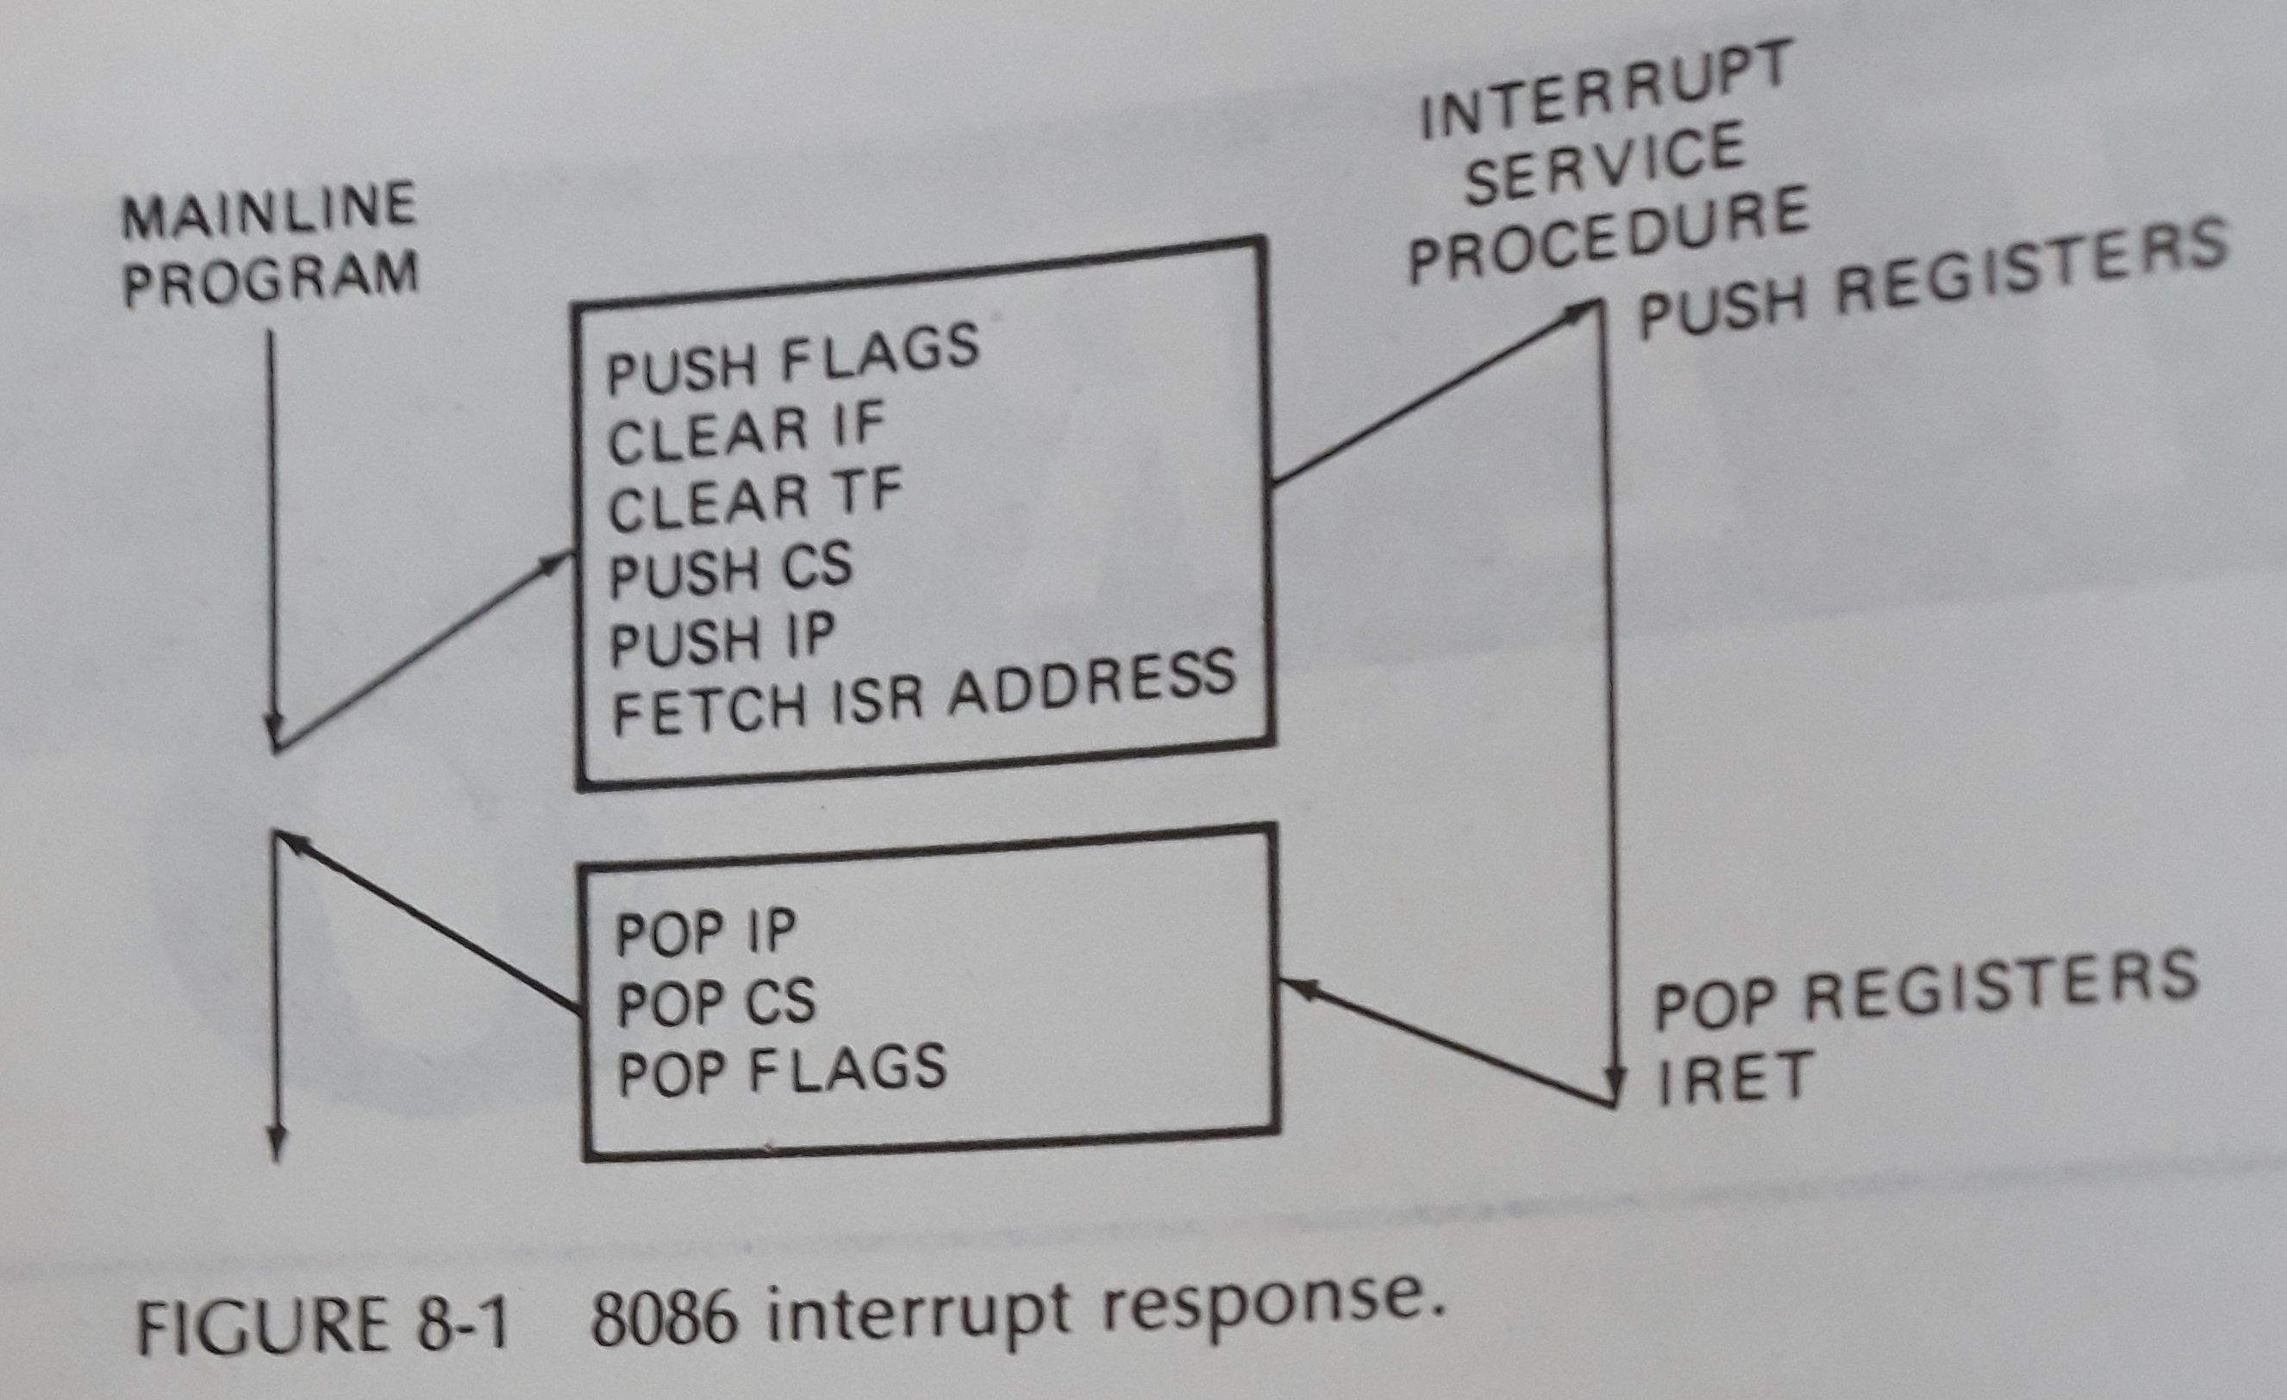
8086 Interrupt Response

Slide 5
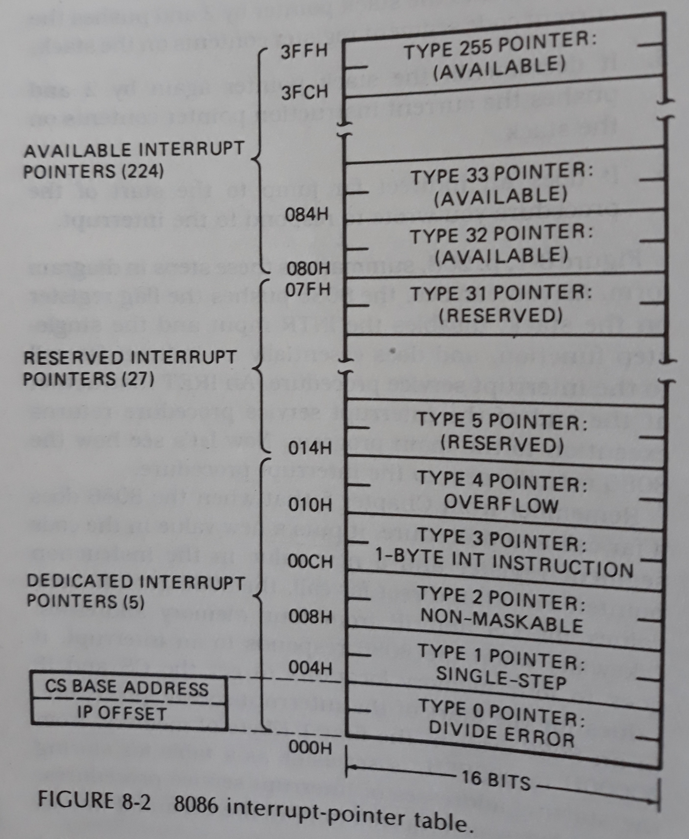
8086 interrupt-pointer table

Slide 6
Divide-By-Zero Interrupt- type 0
Result of DIV or IDIV operation is too large to fit in destination register
Type 0
Get ip and cs from 00000h and 00002h

Slide 7
Software Interrupts
INT instruction can be used to cause the 8086 to do any one of the 256 possible interrupt types.

Slide 8
IF (Interrupt Flag) is automatically cleared as part of the response of an 8086 to an interrupt.

Slide 9
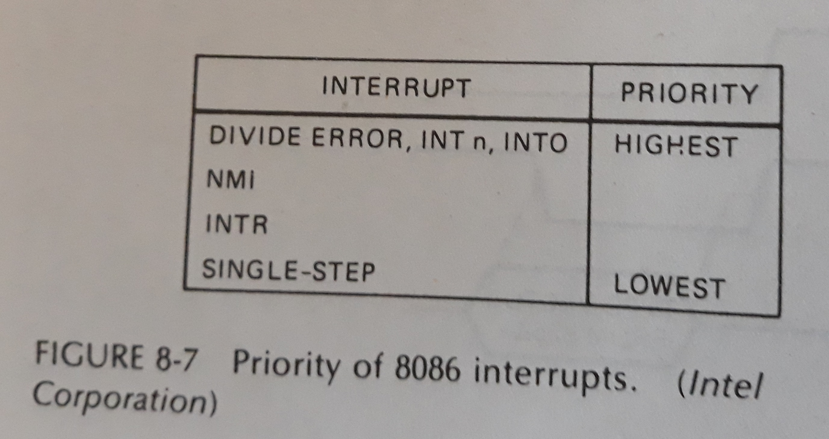
Priority of 8086 Interrupts

